Slide 1


QUANTUM CRYPTOGRAPHY
Presentation by:
S D Hrudhay (1MS20CS098)
Safwan G A (1MS20CS099)
Sai Aishwarya (1MS20CS100)
Sanskar R Gondkar (1MS20CS107)
Supervised by:
Dr. S. Rajarajeswari
(Department of Computer Science and Engineering)

Slide 2
AGENDA
Problem statement
Literature survey
Algorithm explanation
Demonstration
Differences between classical and quantum cryptography
Real-world applications
Some quantum cryptography and encryption companies
Future scopes
Advantages and Disadvantages
Conclusion
References

Slide 3
Problem statement
As the foundation of modern security systems, cryptography is used to secure transactions and communications. Classical cryptography does this by employing approaches that rely on the currently true, ‘fact’ that traditional computers are incapable of factoring huge integers into their prime factors using a polynomial-time algorithm. However, this is also one of its flaws. The goal is thus to make a cryptographic solution that isn’t reliant on assumptions.

Slide 4
Classical cryptography is based on the assumption that mathematical progress does not happen because someone discovers a technique to factorize large prime numbers in polynomial time. This needs a type of encryption that isn't dependent on variables that may or may not change.
The existence of quantum computers is also a concern, because their nature allows them to factor enormous prime numbers using Shor's technique (not yet done, but very doable). This implies that traditional cryptography is on the point of extinction, and having a solution in place before it does so is critical in order to keep information-sensitive organizations like government agencies and banks operational.
Quantum cryptography solves all those problems, since it is dependent on the laws of physics, which never changes and it isn’t reliant on factoring prime numbers, but rather destroying information and alerting communicators if someone is trying to eavesdrop.

Slide 5
Literature survey
Title, Author and Year | Technique used | Result | Remarks
Paper title: Quantum cryptography. Author: Maneesh Yati. Journal name: researchgate. Year: 2020. | Quantum Key Distribution | The result is a mutual key known uniquely to them is created, which can be utilized as a key to scramble and decode messages. | In the research paper, Quantum cryptography and its advantage over conventional cryptography are explained in detail with concepts like cryptanalysis which can help immensely when quantum cryptography is accepted completely.
Paper title: Quantum Cryptography for the Future Internet and the Security Analysis. Author: Tianqi Zhou. Journal name: Hindawi. Year: 2018 | Quantum Key Distribution protocol | The unconditional security and sniffing detection of quantum cryptography, which makes it suitable for future Internet. | This research paper presents benefits that quantum cryptography brings to the future Internet and analyse the security of it.
Paper title: Quantum Cryptography using Quantum Key Distribution and its Applications. Author: N.Sasirekha. Journal name: Blue Eyes Intelligence Engineering & Sciences Publication Pvt. Ltd. Year: 2014. | Quantum Key Distribution, One-time pad | The result is implementation of Quantum Key Distribution. | This paper concludes that to transmit sensitive information between two or more points, some stronger technique is needed which is Quantum Key Distribution.

Slide 6
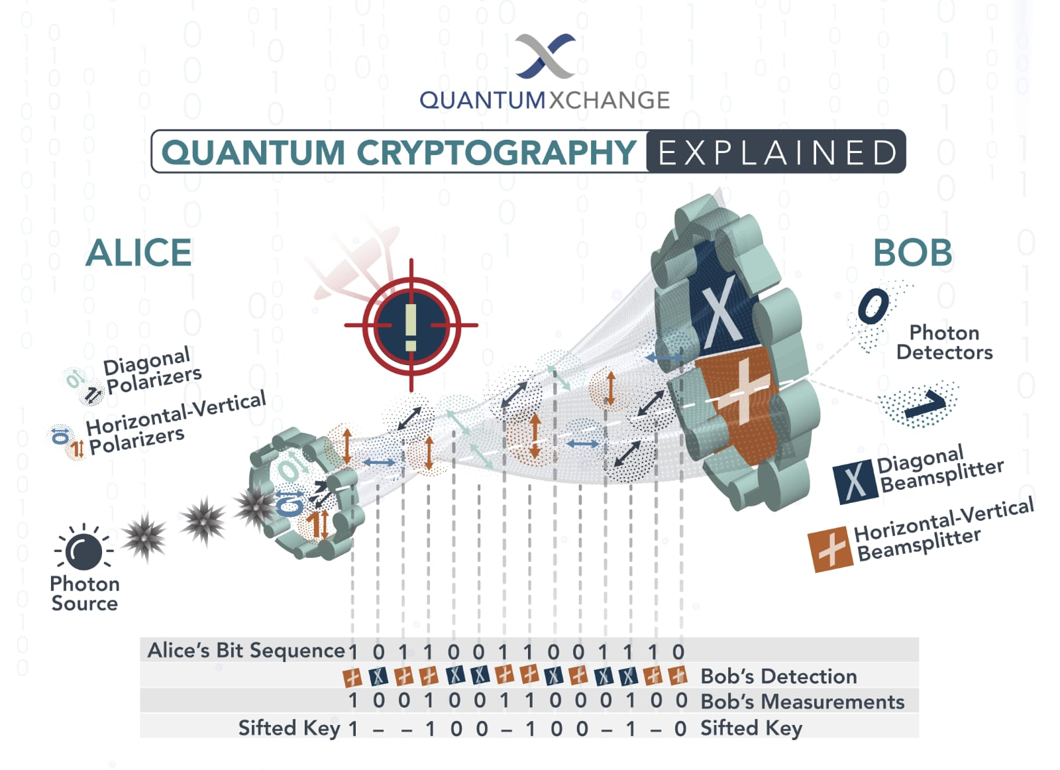
Algorithm explanation
Quantum key distribution relies on the following postulates of quantum theory:
Measuring a particle alters its state
Its impossible to generate a perfect copy of a particle after measuring it.
The way of generation of key is what makes this method secure, as it alerts the communicators about the presence of the eavesdroppers. Both the key sender and receiver have polarizers with them of the kinds ‘+’ and ‘x’ . Now let the sender send a photon through one of the polarisers with one polarisation of the two possible ones corresponding to a one or a zero in a bit. The receiver chooses a random polariser and notes down their results. They then compare the polarisers they used and retain only those bits of information in which the polarisers they used were the same, since only those bits are valid. They’ll now use this key which they both have to encrypt and transmit the data via classical means. Let’s see what happens when we have an eavesdropper over the classical channel.
Fig 1.1: Quantum communication model

Slide 7
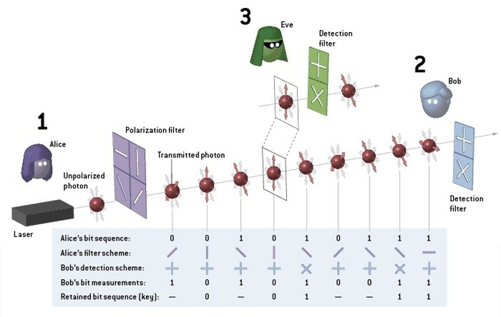
Algorithm explanation
The eavesdropper needs the key to decrypt the message, and will try to steal it. Now when the sender sends a photon, since the polarisation of it is unknown to everybody but the sender, the receiver and the eavesdropper must have to guess the polarisation. When the eavesdropper intercepts the photon, they change some properties of it. When this photon is received by the receiver, the polarisation will be altered. Also, since the key is long, it is nigh on impossible that the interceptor has guessed correctly the polarisation for at least the times when the receiver has. Since the interceptor isn’t sure of the polarisation, they can’t send another photon to the receiver.
Let’s say the above situation happens. Now the key with the sender ,receiver and interceptor are most likely different. Now the sender will encrypt with the key they have, and the receiver will not be able to decrypt it, and neither will the interceptor will be able to do so. This will alert the communicators of an eavesdropper. Since the keys are made for individual packets of data, the interceptor will be caught quick.
Fig 1.2: Quantum communication model

Slide 8
No | Statement | S/E | Average Frequency | Total steps
 | //Input:N,an integer max of length key and Output:Qk[] binary key of length k. | - | - | -
1 | Initialize Qk1[], Qk2[], Qk[] //Qk1 is transmitted via sender, Qk2 is received via receiver | 0 | - | 0
2 | for i ← 0 to N-1 | 1 | N+1 | N+1
3 | Qk1[i].polarisation ← randomOf(diagonal, vertical and horizontal) | 6 | N | 6N
4 | Qk1[i].value ← randomOf(0,1) | 6 | N | 6N
5 | Endfor //sender has now initialised values for themselves | 0 | - | 0
6 | i ← 0
7 | while(i<N) | 1 | N+1 | N+1
8 | Qk2[i].polarisation ← randomOf(diagonal, vertical and horizontal) | 6 | N | 6N
9 | If Qk2[i].polarisation = Qk1[i].polarisation | 1 | N | N
10 | Qk2[i].value ← Qk1[i].value | 1 | N/2 | N/2
11 | Else | - | - | 0
12 | Qk2[i].value ← randomOf(0,1) | 6 | N/2 | 6N/2
13 | i++ | 1 | N | N
14 | Endif | 0 | - | 0
15 | Endwhile //this portrays the values received by the receiver after randomising the polariser | 0 | - | 0
16 | i ← 0 | 1 | 1 | 1
17 | k ← 0 | 1 | 1 | 1
18 | while(i<N) | 1 | N+1 | N+1
19 | if Qk1[i].polarisation = Qk2[i].polarisation | 1 | N | N
20 | Qk[k++]=Qk1[i].value | 2 | N/2 | N
21 | Endif | 0 | - | 0
22 | i++ | 1 | N | N
23 | Endwhile | 0 | - | 0
24 | return Qk[] //only storing values where polarisers used are same discarding others | 0 | - | 0
25 | randomOf(a1,a2) //function which returns a random output based on two given inputs as arguments | 0 | - | 0
26 | i ← randomInt() | 1 | 1 | 1
27 | If i%2 = 0 | 2 | 1 | 2
28 | return a1 | 1 | 1 | 1
29 | Else | - | - | 0
30 | return a2 | 1 | 1 | 1
31 | Endif | 0 | - | 0
Total Steps for Algorithm |  |  | (59N/2)+3 (:.Time complexity is O(N))

Slide 9
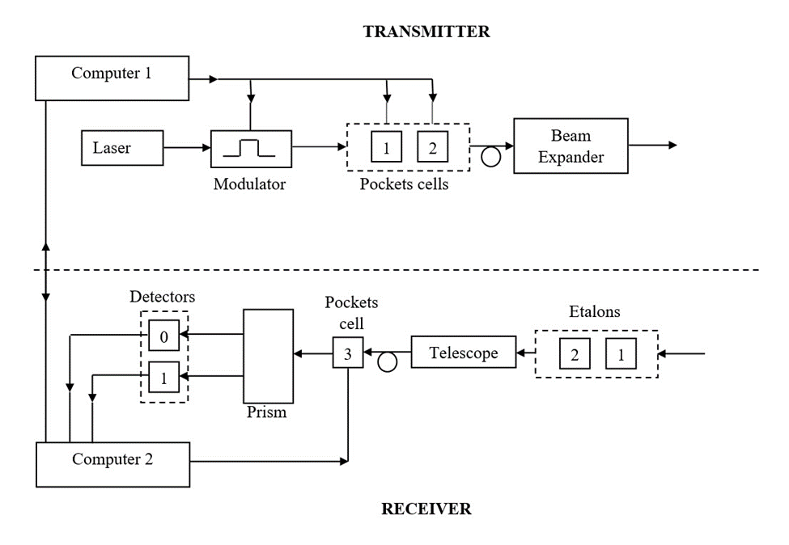
Demonstration
Here the devices are for the following uses:
Laser is the photon projector; modulator modulates it to a given bit.
Pocket cells align it with a certain random polarizer.
Beam expander makes the beam of photons detectable by distributing it over a larger area.
Prism separates different spectrums of photons, to make it possible that the detector only detects photons of a given frequency. Detector detects photons.
The controlling computers on each send instructions to the laser and pocket cells and communicate among themselves about the polarizer they used during the entire communication of key.
The etalon is a device consisting of two reflecting glass plates, employed for measuring small differences in the wavelength of light using the interference it produces. It is used to make sure only the right wavelength is being measured.
Fig 2: System architecture

Slide 10
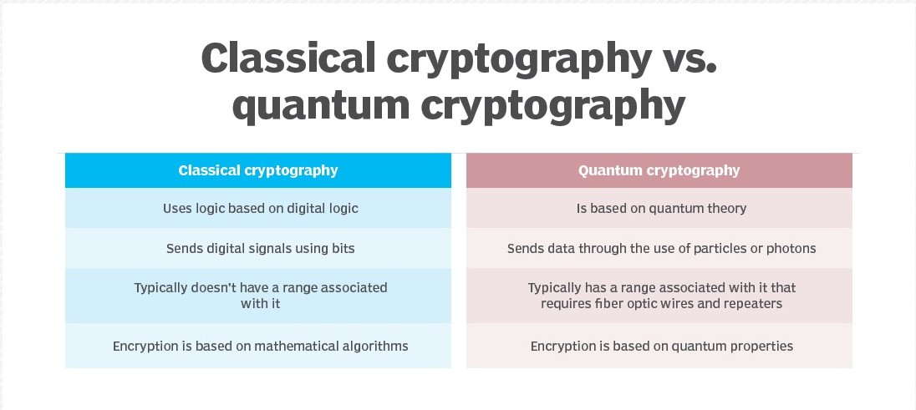

Slide 11
Quantum cryptography in real-world applications
Quantum Key Distribution:- The best-known example of how our modern society uses quantum cryptography is quantum key distribution (QKD). This protected communication method enables the secure distribution of secret keys known only by the authorized parties.
Quantum Coin Flipping:- Another protocol that two participants who do not trust each other can use is quantum coin flipping. The transmission of qubits allows participants to exchange information and communicate via a quantum channel. Coin flipping aims to reduce the bias of a dishonest player (AKA cheating).
Position-Based Quantum Cryptography:- Here the geographical location of a player is used as its (only) credential. For instance, a participant sends a message to the receiving party at a known position to guarantee that the recipient can only read the data at the specified location.
Measurement-Device-Independent Quantum Cryptography:- A unique protocol, often referred to as MDI, removes all attacks from the detection system, the most vulnerable part in many cryptographic implementations. As a result, security is held independently of the quality of the underlying physical devices.

Slide 12
Some quantum cryptography and encryption companies
Agnostiq (Canada):- Agnostiq is a quantum cryptography company founded in 2018 by Otkay Goktas, Elliot MacGowan and Ewin Tham, Toronto-based Agnostiq specializes in providing cloud-based users with security software.
Crypto Quantique (UK):- Crypto Quantique is a British quantum cryptography startup based in London that ‘is building the most secure end-to-end IoT security platform’, while at the same time determined to revolutionize the quantum cybersecurity industry.
InfiniQuant (Germany):- A project focusing on the commercialization of quantum encryption, Germany’s InfiniQuant, which was incorporated in 2018, is supported by the Quantum Information Processing group of Christoph Marquardt at the Max Planck Institute for the Science of Light.
MagiQ Technologies (US):-MagiQ Technologies is a quantum encryption company founded in the same year as D-Wave Systems way back in 1999 by Bob Gelfond, MagiQ is based in Somerville, Massachusetts (not far from Harvard University and MIT), and is famous for being the first company to commercialize a ‘quantum cryptography product that delivered advanced, future-proof network security’.
QNu Labs (India):-The first and only Indian startup on the list, QNu Labs began life in 2016 in the Silicon Valley of the country, Bengaluru.

Slide 13
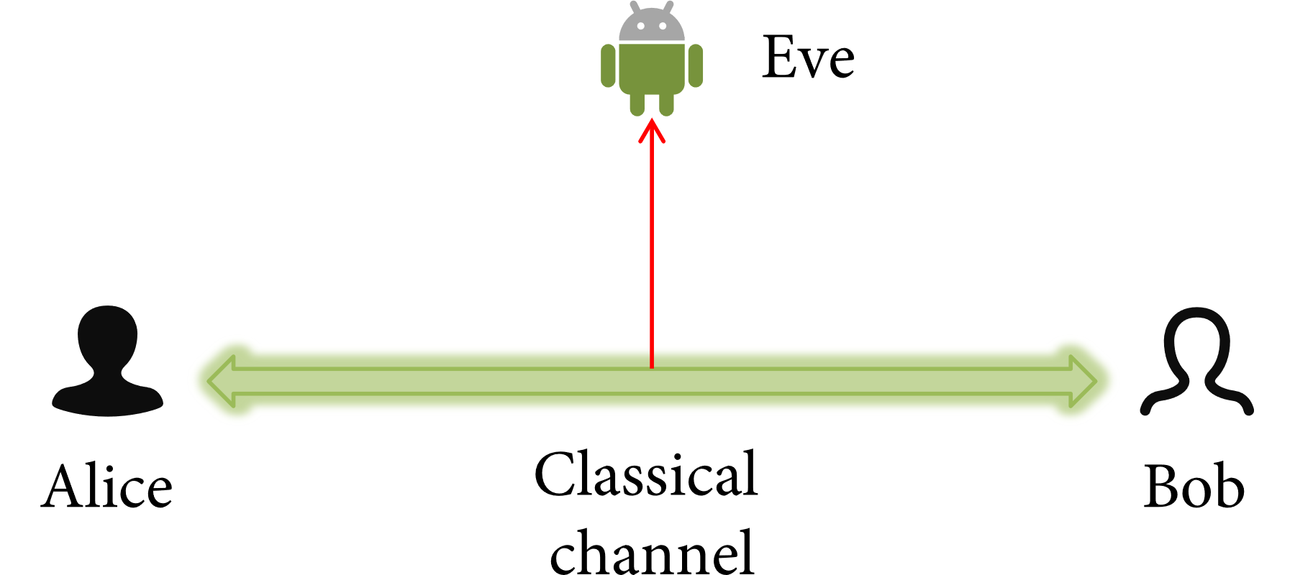
Future scopes
Unconditional Security:-
Cable and light are the main carriers of today’s Internet communication. This communication system model is shown in Figure. Let Alice and Bob be legitimate users in the system with Eve being an eavesdropper. In order to ensure security, the duo encrypt messages and then transmit it on the public channel. The classical cryptographic-system is roughly divided into two kinds, which are symmetric key cryptosystems and asymmetric key cryptosystems.
For these two cryptographic-systems, their security is mostly based on the complexity of computing. However, the rapid development of hardware equipment and the newly-proposed advanced algorithms have presented unprecedented challenges to the security of classical cryptographic-systems.
.
.
Fig 3: Classical communication model

Slide 14
Sniffing Detection:-
Alice and Bob exchange information in public channel. In order to ensure confidentiality, their information is encrypted, but they cannot prevent an attacker from eavesdropping on the channel. Moreover, because of the characteristics of the device itself, the eavesdropper can not be detected whether it is in cable communications or in optical fiber communications.
Security of the QKD:-
In this subsection, in order to simulate real situations in the future Internet, we first analyze the quantum key distribution protocol in noise-free channel. Moreover, we further search the quantum key distribution protocol in noisy channel.
In order to analysis security of QKD protocol, we list the encoding of quantum information and the measurement results under different measurement bases. The two parties agree in advance that the horizontal and oblique downwards polarization represents “1” while the vertical and oblique upward polarization represents “0”.
From the above discussion, we can conclude that the quantum cryptography offers unconditional security and the sniffing detection properties for secure communication. These properties can ensure security for cyberspace in the future Internet.

Slide 15
Advantages and Disadvantages
Advantages:-
It detects eavesdropping in real-time.
It relies on unchanging laws of physics.
The eavesdropper needs to have exactly identical equipment as the sender and receiver, which is highly impractical.
Disadvantages:-
While travelling through the channel(i.e. optical fibre or air) there is possibility of change in polarization of photon due to various causes.
It is very distance sensitive and costly.
While sending a single photon is impractical, sending several would allow only some of them to be intercepted, rendering the encryption useless.

Slide 16
Conclusion
Based on quantum mechanics and classical cryptography, quantum cryptography is a novel one in the field of cryptography. Compared with classical cryptography, its ultimate advantages are the unconditional security and the sniffing detection. These characteristics can solve cyberspace security critical problem for the future Internet.
In particular, quantum cryptography provides security for various applications (e.g., Internet of things and smart cities) in cyberspace for the future Internet. Our experimental analysis results show the unconditional security and sniffing detection of quantum cryptography, which makes it suitable for future Internet.

Slide 17
References
Bennett, C.H, Brassard. And Ekert, A.K. Quantum cryptography. Sci. Am. 267, 4 (Oct, 1992), 50.
Bennett, C. H., and Shor, P. W. Quantum information theory. IEEE Transactions on Information Theory 44, 6 (1998), 2724–42.
J. Shen, J. Shen, X. Chen, X. Huang, and W. Susilo, “An efficient public auditing protocol with novel dynamic structure for cloud data,” IEEE Transactions on Information Forensics and Security, vol. 12, pp. 2402–2415, 2017. View at: Publisher Site | Google Scholar.
J. Li, Y. Zhang, X. Chen, and Y. Xiang, “Secure attribute-based data sharing for resource-limited users in cloud computing,” Computers & Security, 2017. View at: Publisher Site | Google Scholar.
T. Zhou, L. Chen, and J. Shen, “Movie Recommendation System Employing the User-Based CF in Cloud Computing,” in Proceedings of the 2017 IEEE International Conference on Computational Science and Engineering (CSE) and IEEE International Conference on Embedded and Ubiquitous Computing (EUC), pp. 46–50, Guangzhou, China, July 2017. View at: Publisher Site | Google Scholar.
R. L. Rivest, A. Shamir, and L. Adleman, “A method for obtaining digital signatures and public-key cryptosystems,” Communications of the ACM, vol. 21, no. 2, pp. 120–126, 1978. View at: Publisher Site | Google Scholar | Zentralblatt MATH | MathSciNet .

Slide 18
THANK YOU

